Slide 1

Keeping up with the kids
Parents/Guardians

Slide 2

Why should we take all of this seriously?
Cyberbullying | Grooming | Inappropriate Content | Overuse & Addiction
Viruses/Hacking | Online Reputation | Losing Control of Photos/Videos

Slide 3

School vs Home
School | Home
Acceptable use policies | Agreements?
Internet safety policies | Do you regularly discuss how they use the internet?
Digital Literacy lessons | Do you manage how the internet is accessed on all devices?
Use of proxy server or filter to manage internet access

Slide 4

Which apps are your children using?
Which apps do they regularly use?
Do you know the age restrictions?
Are you aware of any issues?
Do you know how to keep them safe when they are online?

Slide 5








Which apps are you using?
Whatsapp
13+
Tik Tok
13+
Youtube
13+ with parent permission to post videos
Instagram
13+
Snapchat
13+
Facebook
13+
Roblox
No age limit
Twitch
13+
Notes:
If you set up an account using a fake age, the app will start showing content for that age. So if you pretend at 8 to be 13, you will see adverts for 18 year olds when you turn 13!!!

Slide 6
Social media - what is the law?
The age of criminal responsibility in England and Wales is 10 years old.
Children between 10 and 17 can be arrested and taken to court if they commit a crime.
New criminal offences are being introduced so that things like 'trolling' or purposefully targeting people and sending people unsolicited inappropriate images will all be a crime.
It can be considered a criminal offence if cyberbullying causes a victim ‘alarm or distress’.

Slide 7


Online Contact and Staying Safe
Chatting and meeting new people on the internet can be fun and appealing for children. There are lots of online apps and communities that can be educational and supportive for them, however there are also opportunities online for adults to contact children.
No matter how old your child is, if they are using a device that has the internet - it is important to talk to them about people who contact them online.

Slide 8
Online Contact and Staying Safe
“Children have told us that they send out friend requests to increase their friend count, and are worried that if they have talked to people they don't know and something goes wrong or upsets them, their parent or carer will overreact and take their technology away from them.”

Slide 9
How to protect children from inappropriate contact
Look out for your child moving to new platforms to chat. Offenders sometimes encourage young people to move from a public forum, to a game, or more private chat apps or sites. Here, they are able to have private conversations that are likely to be less moderated.
Use webcam and devices in public spaces. Encourage young people to use their devices in spaces where some level of supervision is possible, for example, a family room or living room.

Slide 10
How to protect children from inappropriate contact
Encourage your child to identify safe and trusted adults. Some offenders rely on young people’s trust in adults to harm them. Help your child to identify adults that are there to help them from ones who they do not know. Help them to identify sources on the internet that they can trust and places they should be more cautious.
Make sure your child knows where to go for support. Children can sometimes feel partly to blame if something goes wrong online. Remind your child that they can always speak to an adult they trust if they are worried no matter what may have happened.

Slide 11

Spot the signs
They have stopped using their electronic devices suddenly or unexpectedly
They seem nervous or jumpy when using their devices, or have become obsessive about being constantly online
Any changes in behaviour such as becoming sad, withdrawn, angry or lashing out
Reluctant to go to school or take part in usual social activities
Unexplained physical symptoms such as headaches or stomach upsets
They avoid discussions about what they’re doing online or who they’re talking to

Slide 12

Bullying or Banter?
We need to support children in developing empathy and understanding the impact of their online actions.
While it might be difficult to think about your child behaving negatively towards someone else, it’s worth bearing in mind that sometimes young people find it hard to identify what bullying is and may just think the behaviour is ‘banter’ and to be expected.
It’s important they recognise what behaviour is acceptable and recognise how online actions can affect others.

Slide 13
If your child has experienced cyberbullying:
Let them talk. Give them the space to share what they want to in their way and listen. Try to avoid the temptation to interrupt, let them do most of the talking.
Don’t be shocked by what they tell you. Times change and some of the things young people do today may make us cringe sometimes, but the inherent behaviour is the same as it was when we were their age.
Don’t deny access to technology. When we speak to young people about barriers to getting help they often share that they are worried that their device may be taken away from them. Reassure them that this won’t happen if they speak up about something that has been worrying them online.

Slide 14
Encourage them not to retaliate. Most of the time the bully is looking for a reaction. Your child may wish to reply and ask the person to stop sending messages however this is not necessary and action can be taken without replying.
Save the evidence. It’s important to keep the cyberbullying messages that a child has received, whether through taking screenshots or saving the messages on the device. Saving the messages allows you to have evidence when reporting the cyberbullying.
Talk to their school. They will want to know about any incidences that could potentially affect a child’s wellbeing. Take the evidence of bullying and any additional details about the context of the situation. It is helpful to discuss this with your child and you may want to speak to the school together.
Talk to the police. If you think that your child is in immediate danger don’t hesitate to call the police.

Slide 15


Top tips
Talk to your child about what they’re doing online.
Be aware of social pressures and explore resources that could help them
Familiarise yourself with your child’s favourite apps, games and sites

Slide 16
Top tips
Turn off notifications
Remind your child to be kind online
Explore wellbeing settings and apps
Focus on the positives of being online
Keep evidence if there are issues e.g. cyberbullying

Slide 17
How to…

Slide 18

Apple - set up family sharing
You only need to set up Family Sharing on one device. Then it’s available on all your devices that are signed in with the same Apple ID.
Go to Settings > [your name] > Family Sharing, then follow the onscreen instructions.
Add one or more family members. When you add an adult family member, you can designate them as a parent or guardian.
Tap a feature you want to set up for your Family Sharing group, then follow the onscreen instructions.
To set up parental controls or Apple Cash for a child, tap their name, tap the feature, then follow the onscreen instructions.

Slide 19

iPad child restriction settings
Settings - Screen Time
Tap Turn on Screen Time, then tap it again. Choose "This is My [Device]" or "This is My Child's [Device]".
Follow the prompts until you get to Screen Time Passcode and enter a passcode.
Make sure you choose a passcode that's different from the passcode you use to unlock your device.

Slide 20
Setting downtime
Setting downtime means that only apps you have
selected will be available during the time.
Settings - Screen Time
Choose your child’s device.
Select downtime and enter your passcode.
Downtime can be scheduled for the same time each day or customised.

Slide 21
Set usage limits (child account)
Go to Settings and tap Screen Time.
Tap child device name then app limits.
To set limits for individual apps, tap the category name to see all the apps in that category, then select the apps you want to limit.
Tap Next, then set the amount of time allowed.
To set an amount of time for each day, tap Customize Days, then set limits for specific days.
When you finish setting limits, tap Add.

Slide 22
Set usage limits (child account)
When you select the device you can also set apps that are always allowed e.g. Phone or Messages.
You can choose contacts to choose specific people who can be contacted during downtime. So while messaging may be available in downtime it will only be to named contacts.

Slide 23
Prevent iTunes & App Store purchases
Go to Settings and tap Screen Time.
Tap Content & Privacy Restrictions. If asked, enter your passcode.
Tap iTunes & App Store Purchases (or App Installations & Purchases).
Choose a setting and set to Don't Allow.

Slide 24
Allow built-in apps and features
You can restrict the use of built-in apps or features.
Go to Settings and tap Screen Time.
Tap Content & Privacy Restrictions.
Enter your Screen Time passcode.
Tap Allowed Apps.
Select the apps you want to allow.

Slide 25
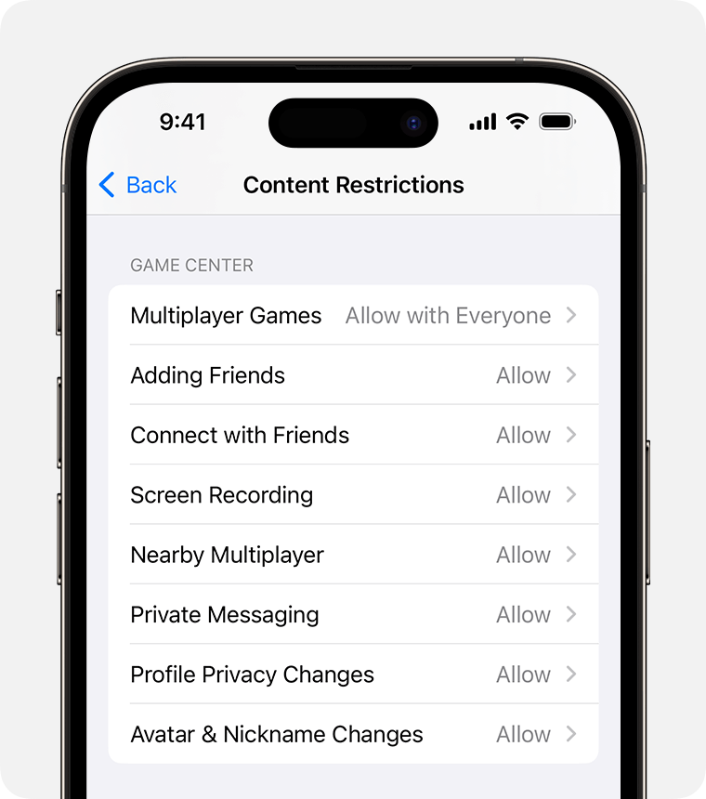
Restrict Game Center
Go to Settings and tap Screen Time.
Tap Content & Privacy Restrictions, then tap Content Restrictions.
Scroll down to Game Center, then choose your settings.

Slide 26

Whatsapp
Tap the cog – or ‘Settings’ – on the bottom right of the app’s main page, then ‘Account’, then ‘Privacy’.
From here you can adjust what others can see on your child’s profile:
‘Last Seen’ shows when they were last using the app;
‘Profile Photo’ shows their profile photo;
‘About’ reveals your child’s personal details;
‘Status’ reveals what they are doing now.

Slide 27
Whatsapp (Locations)
It can be dangerous for someone to know the location of your child.
To remove ‘Live Location’, tap the cog – or ‘Settings’ – on the bottom right of the app’s main page,
Then ‘Privacy’.
When you tap ‘Live Location’ you can choose the chats from which you want your child’s location to be removed.
Live locations can be sent while in a chat for limited times, this can be useful if you want to know where your child is!

Slide 28

Snapchat - who can contact you?
Choose who can contact you on Snapchat:
Tap the icon in the top left corner, then the settings cog in the top right corner.
Scroll to contact me
Friends - only people you have added to Snapchat as friends can contact you.
Friends and contacts - people you have added on Snapchat or have as contacts on your phone.
Similar steps can be taken to decide who can see your stories.

Slide 29
Snapchat - Location sharing
Choose who can contact you on Snapchat:
Tap the icon in the top left corner, then the settings cog in the top right corner.
Scroll to ‘See my location’
Ghost mode - friends cannot see your location
If ghost mode is off then you can choose who sees your location - Friends; Friends, except…; Only these friends.
Hide my live location means friends can’t see where you are on the snapchat map

