Slide 1
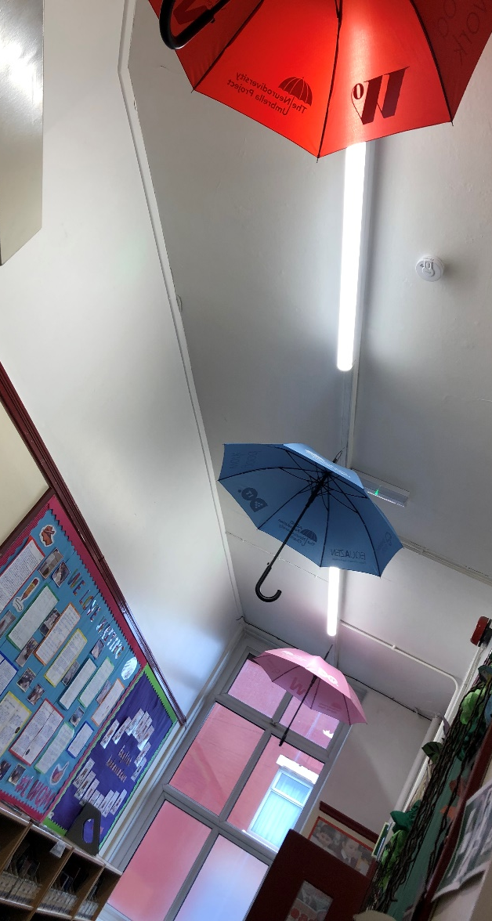
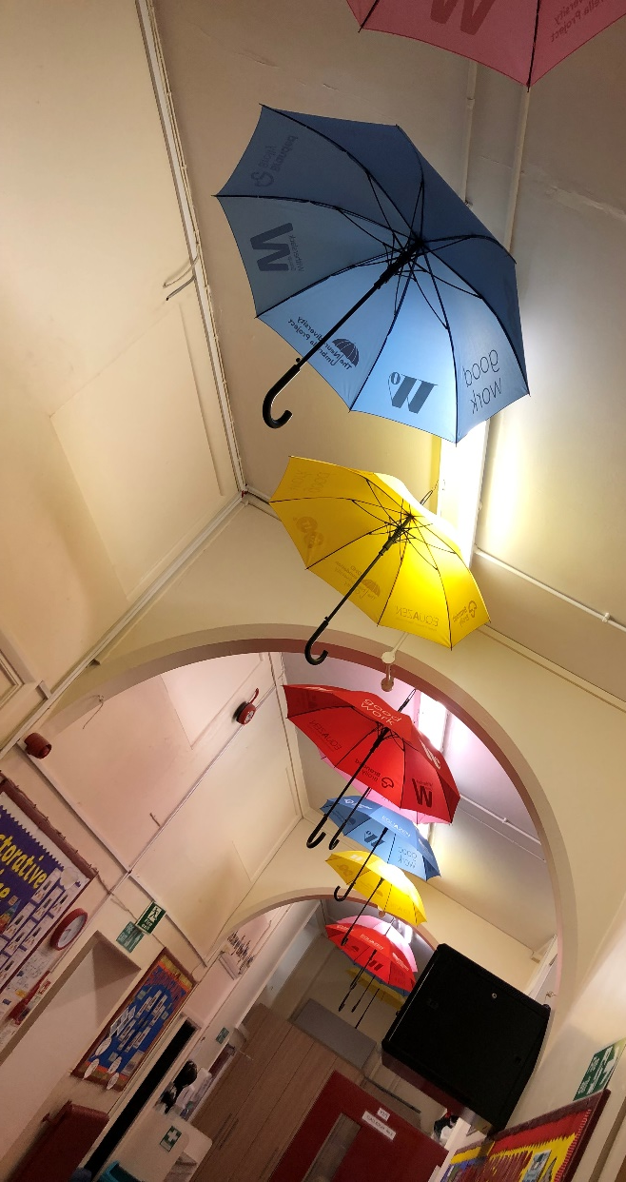
We are an
Inclusive School where
we celebrate Neurodiversity.

Slide 2

Pass on your SEND concerns to the SENCo’s:
Miss Creer EYFS and KS1 & Ms Lea KS2.
Chat with your child’s class teacher.
Early intervention is key and parents are the experts; you know your child best.

Slide 3

The Graduated Approach
Where a pupil is identified as having SEND, we act to remove barriers to learning and put effective special educational provision in place.
Our SEND support takes the form of a four-part cycle. • Assess • Plan • Do • Review
This approach is reviewed 3 times a year and includes the child, parent/carers and any external specialist agencies involved.
All SEND pupils receive a pupil profile which identifies the pupils’ strengths, interests and areas of SEND.
It will also include provision and additional support the pupil receives.
Targets are set 3 X a year and shared with all carers and parents at open evening.

Slide 4

ROAR is our whole school response to recognising and addressing the early signs of mental health problems in children.
All our staff are trained in using ROAR .
Resilience is at the heart of ROAR and through circle time in class; PSHE lessons and themed mental health weeks we aim to build resilience in all our pupils.

Slide 5


Slide 6
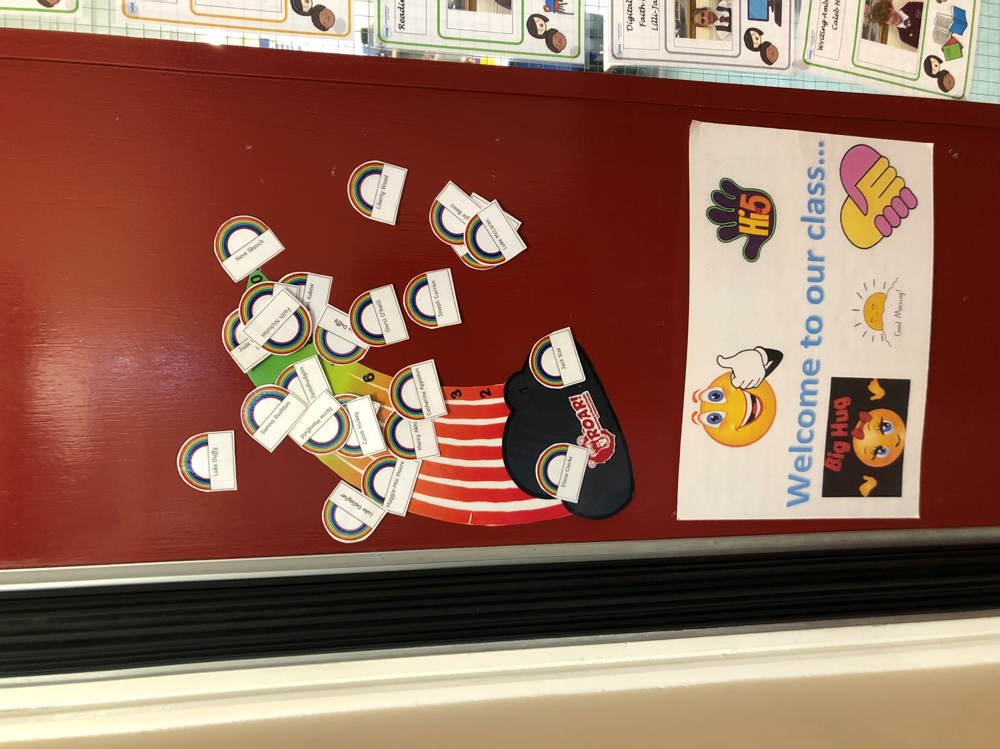
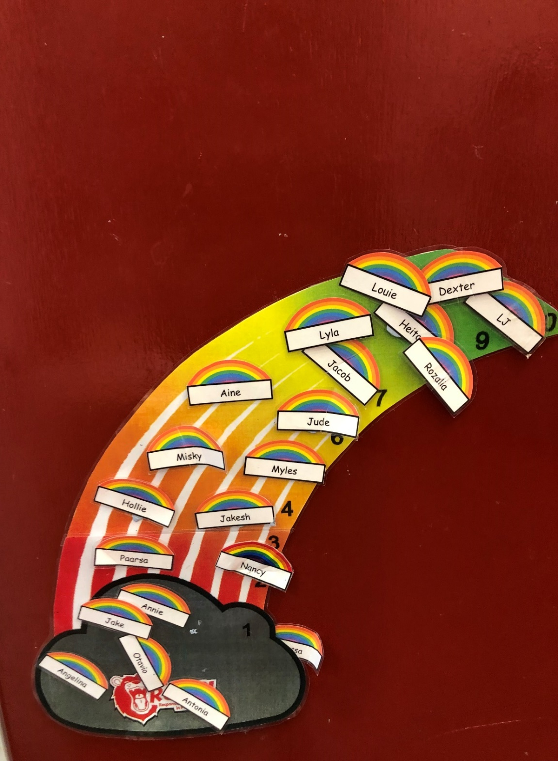

Slide 7
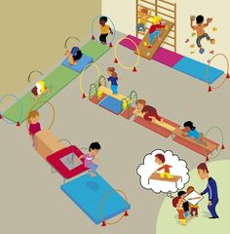
SENSORY CIRCUIT SESSIONS
A sensory circuit is a series of exercises that a child works through in a specific structured order to Alert; Co-ordinate and Calm the child. It is intended to focus concentration to prepare a child for learning and support self-regulation throughout the day.

Slide 8
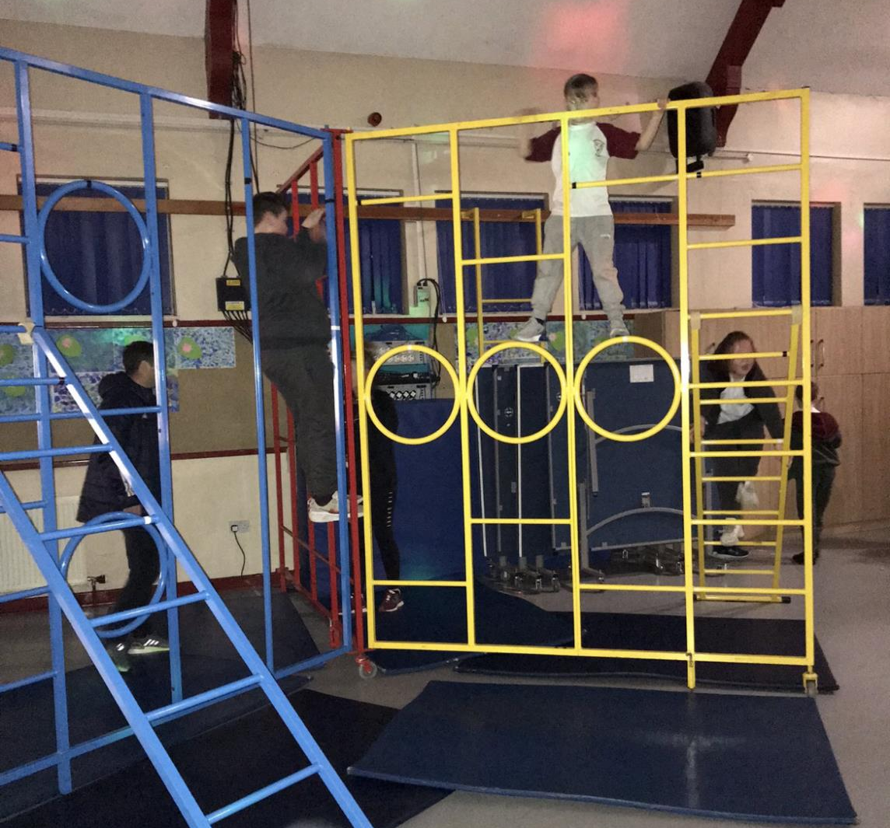
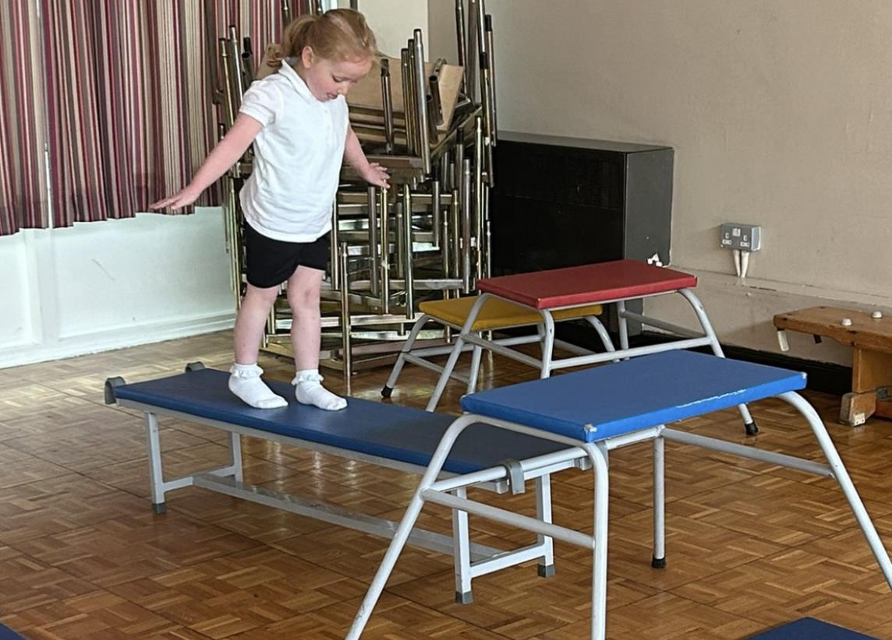
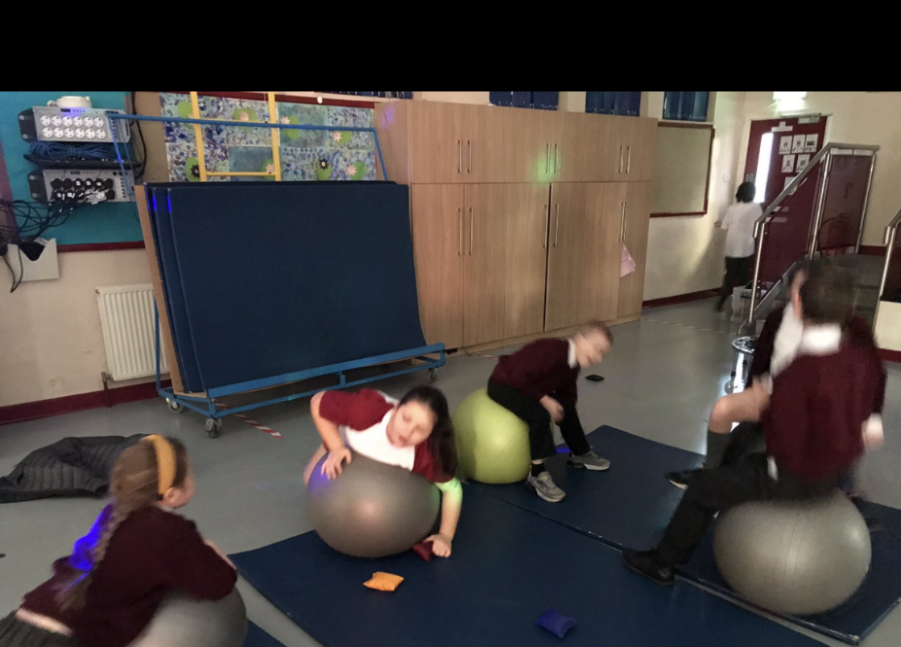

Slide 9







Mental Health Support at St Cecilia’s Catholic Junior School
ELSA
Emotional Literacy Support Assistant
MHST
YPAS

Slide 10



Parent/Carer Early Help Drop in sessions
at the Infant Building of
St Cecilia’s Primary School every other Wednesday 12pm-3pm
Hannah Bate I Family Support Worker from Clubmoor Children’s Centre, Utting Avenue East, Liverpool L11 1DQ E: hannah.bate@liverpool.gov.uk
Hannah will offer support and advice on topics such as: Attendance, SEND, Mental Health and much more; she will be able to signpost parents/carers to a whole range of services.
If you’d prefer a phone call from Hannah please let me know and I will pass on your contact details.
September 24

