Slide 2
Disclaimer/s
We hope you find the information on our website and resources useful.
Animations
This resource has been designed with animations to make it as fun and engaging as possible. To view the content in the correct formatting, please view the PowerPoint in ‘slide show mode’. This takes you from desktop to presentation mode. If you view the slides out of ‘slide show mode’, you may find that some of the text and images overlap each other and/or are difficult to read.
To enter slide show mode, go to the slide show menu tab and select either from beginning or from current slide.
You may wish to delete this slide before beginning the presentation.

Slide 3
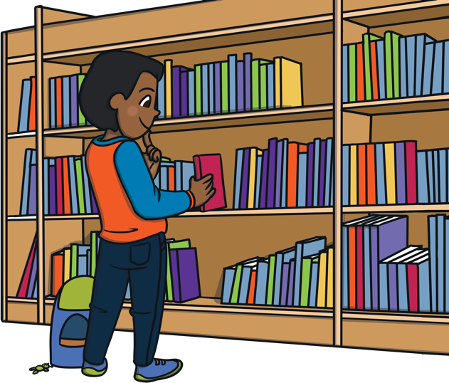
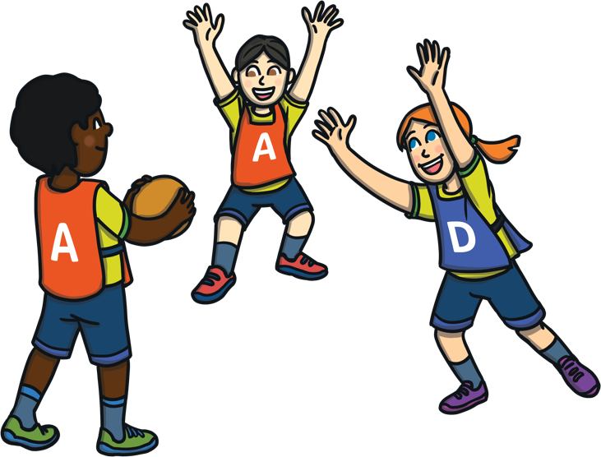
At school I do lots of fun learning
activities in the classroom.
Sometimes I do activities with my class in other rooms, like the Art Room or Library, or go outside for P.E.

Slide 4

When I am at school, I might need to practise safety drills. Drill means practise. We might practise going outside in a fire or finding a safe place during a lockdown.
In a lockdown drill, we pretend that there is danger outside and we need to go or stay inside to make sure we are safe.

Slide 5


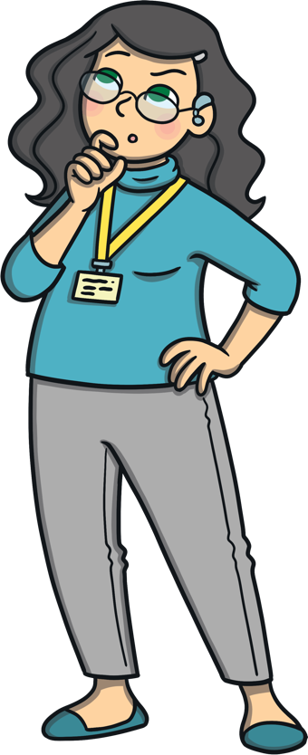
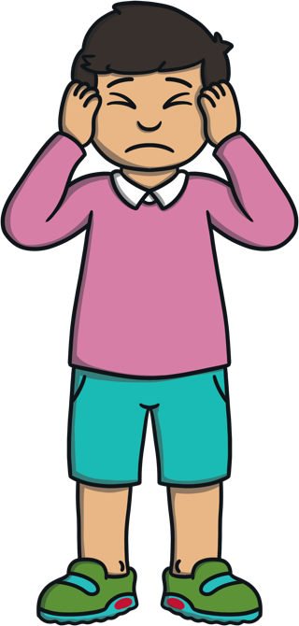
When the lockdown drill happens, I will
hear a loud noise like a siren or bell. I
might also hear an announcement.
My teacher will listen to the announcement
so they can know what is happening.

Slide 6
Then my teacher will tell me and my class what we need to do next. In a lockdown, this means we stop what we are doing and sit together on the floor. My teacher might tell me to sit under a table or in a safe space where no one can see us. I might need to wait for a while. My teacher will tell me when it is safe to move.

Slide 7
If I am outside when I hear the lockdown siren, the teacher I am with will tell me what to do. This will usually mean we walk calmly to the closest building and go inside.
I might have to sit in a different room to make sure that I am safe. The teacher and my friends will be with me.

Slide 8
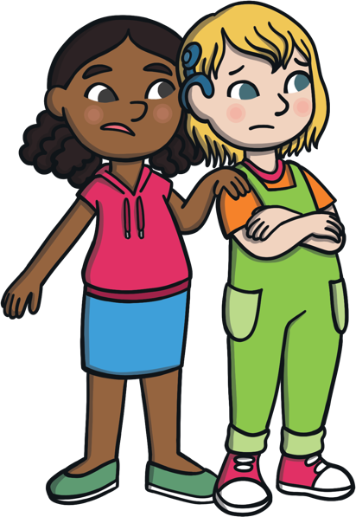
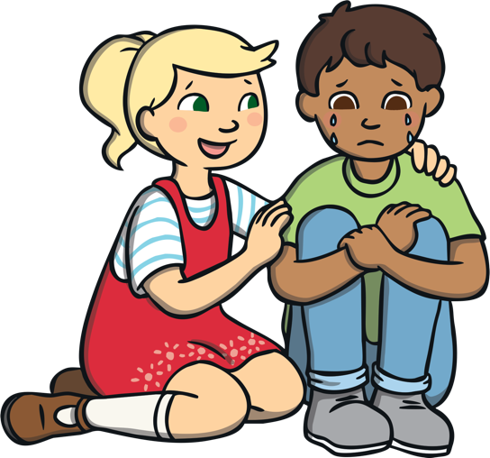
Some students might feel a bit anxious or worried about doing the lockdown drill. It is ok to have these feelings.
We practise doing lockdown drills so that if a real situation happens, we know what to do. Practising a lockdown drill might help me feel better about the situation.

Slide 9
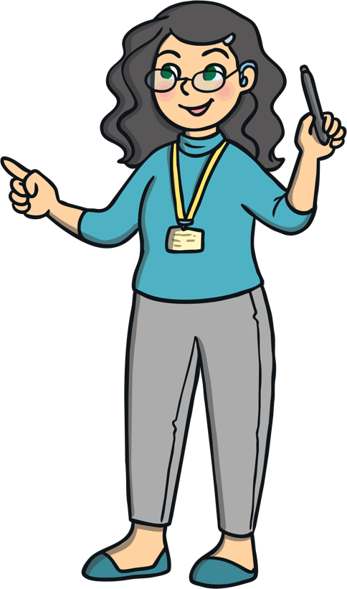
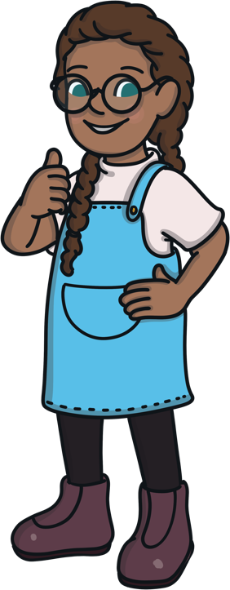
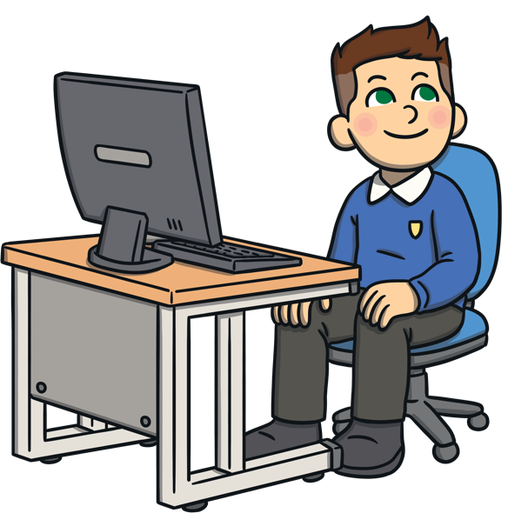
When there is a lockdown drill, it is a good idea to listen to my teacher. My teacher will tell me where
to go and how to be safe. I will try and listen to my teacher and stay inside so I am safe.

