Slide 1
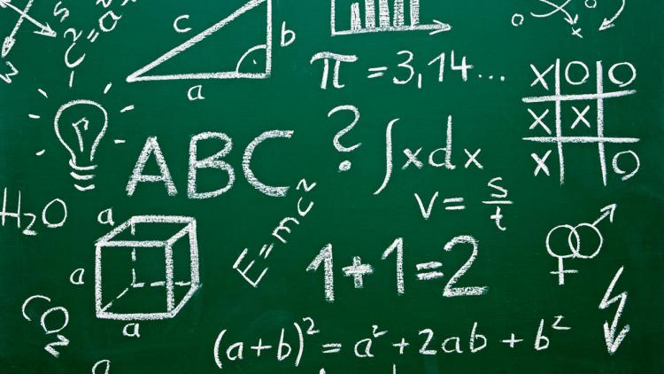
Everyday Maths

Slide 2
When you're a kid, you may think that maths is worthless. After all, when are you ever going to have to know how to calculate the area of a triangle?
Well, if you're filling in an area in your garden with compost, you might have to do just that.

Slide 3
Wherever you go, whatever you do, you are using maths daily without even realising it.

Slide 4
The maths ambassadors interviewed some people around the school to see how they used maths.

Slide 5
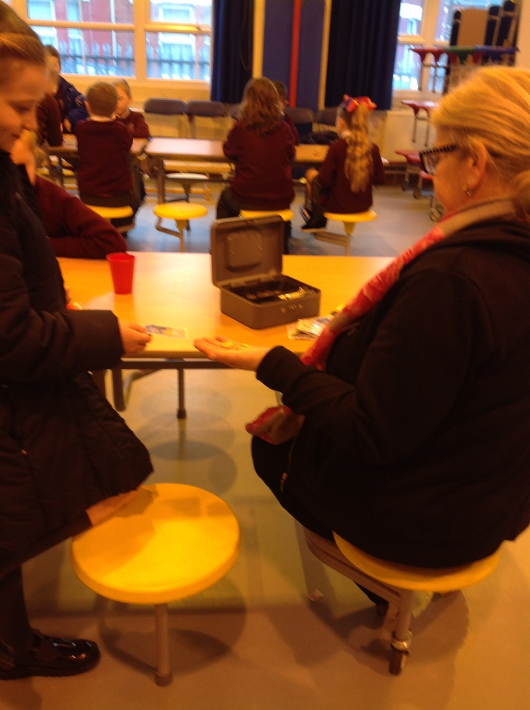
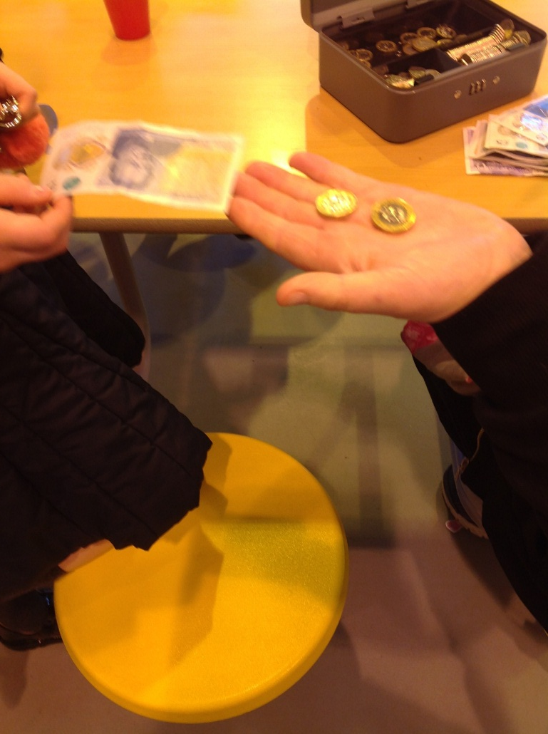
Every morning pupils arrive at school to have breakfast and play some games.
It costs £3.00 a day to attend breakfast club and Mrs friend uses maths to work out what change to give.

Slide 6
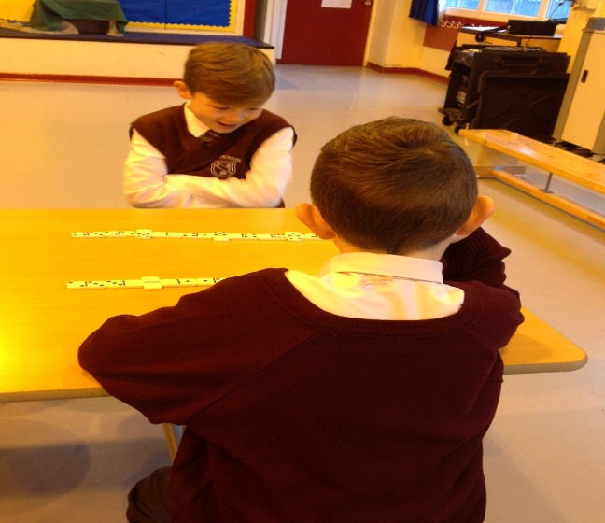
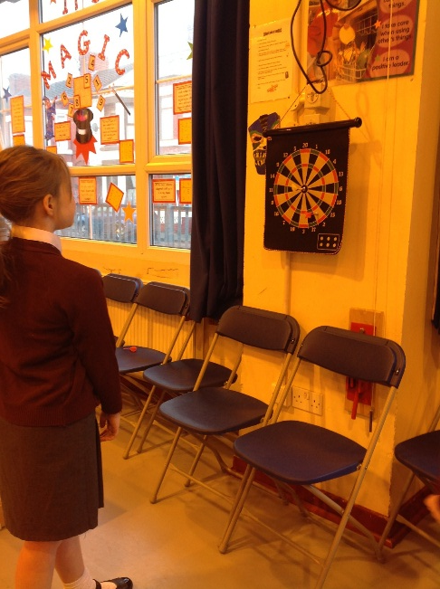
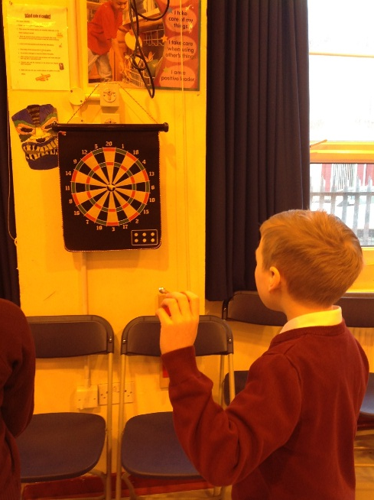
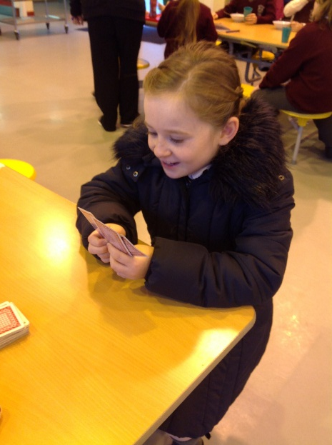
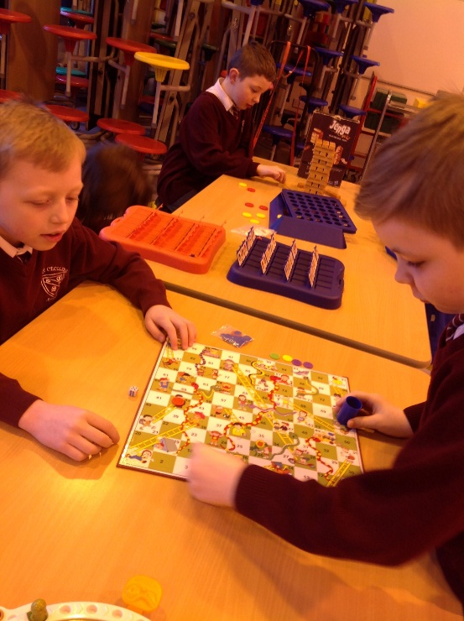
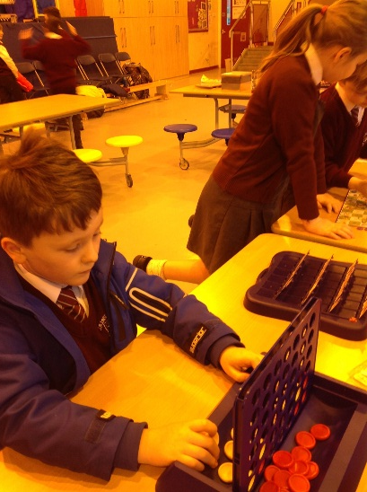
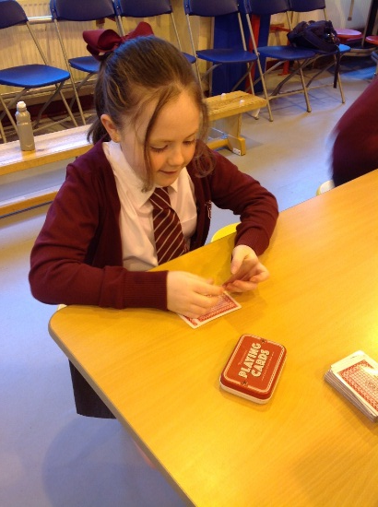
We enjoy learning while we have fun, there are lots of maths games to play.
Darts
Dominoes
Connect 4
Cards
Snakes and ladders

Slide 7
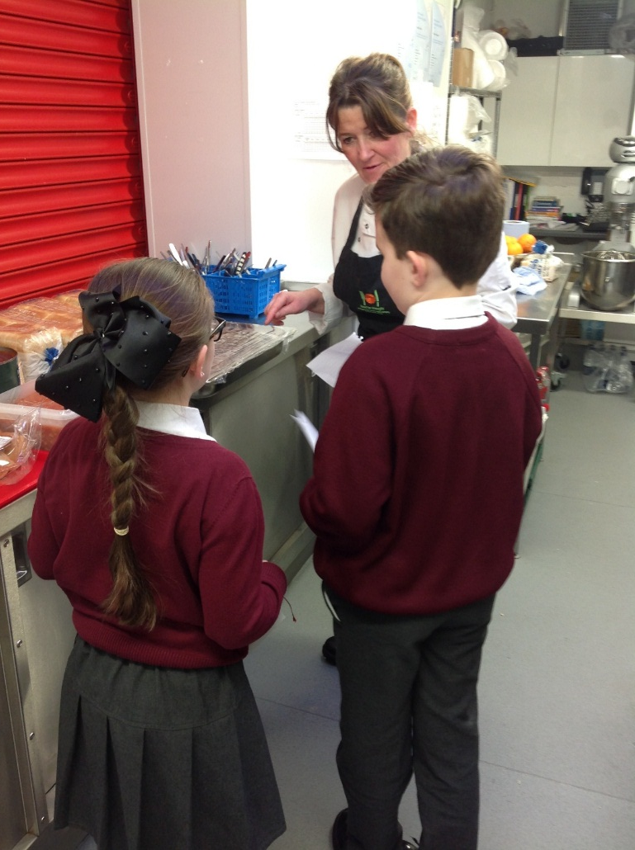
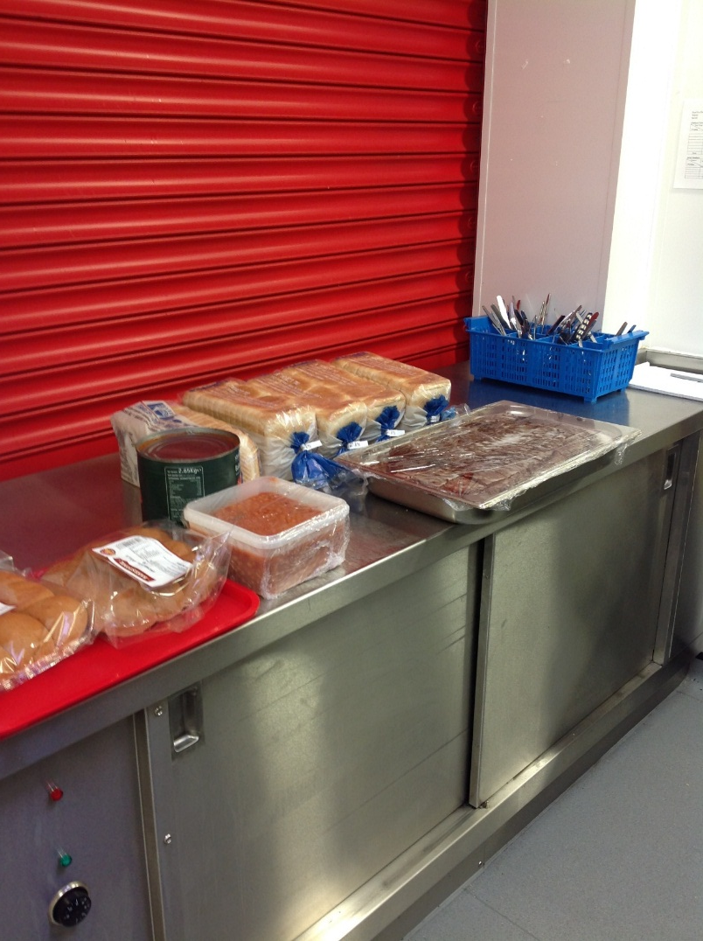
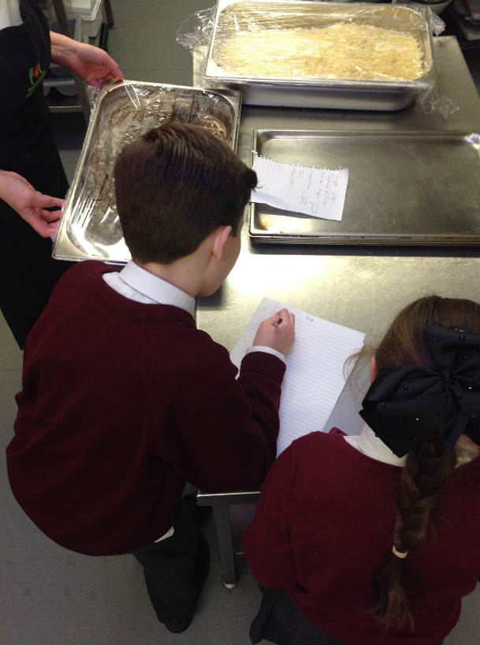
Tracy uses maths to calculate how many dinners she needs to make every day.
Ratio is used to work out the different portion sizes.

Slide 8
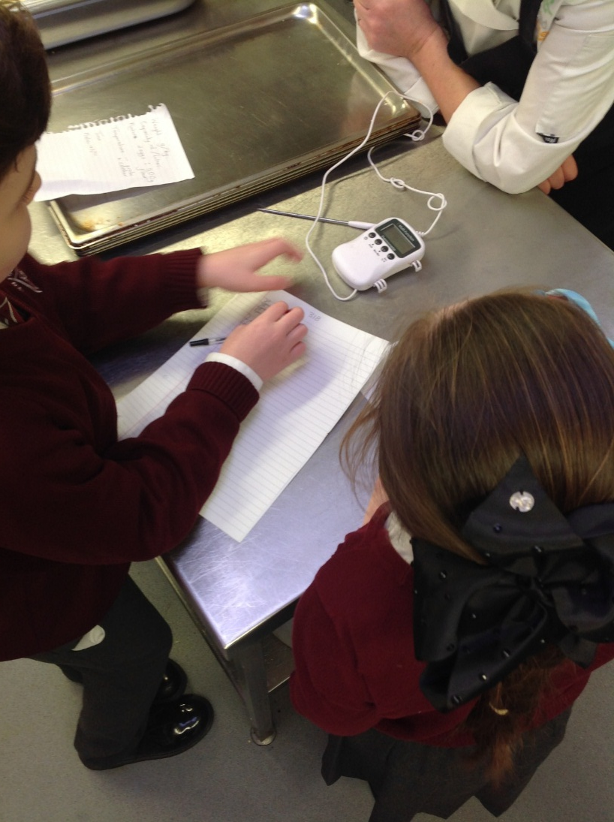
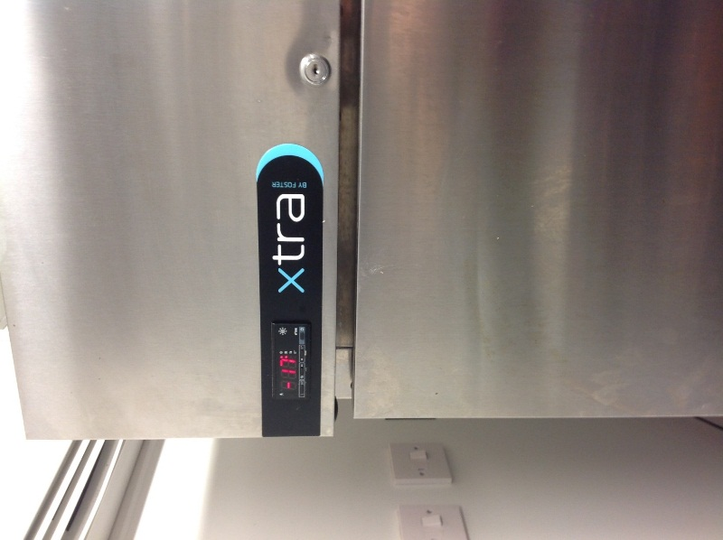
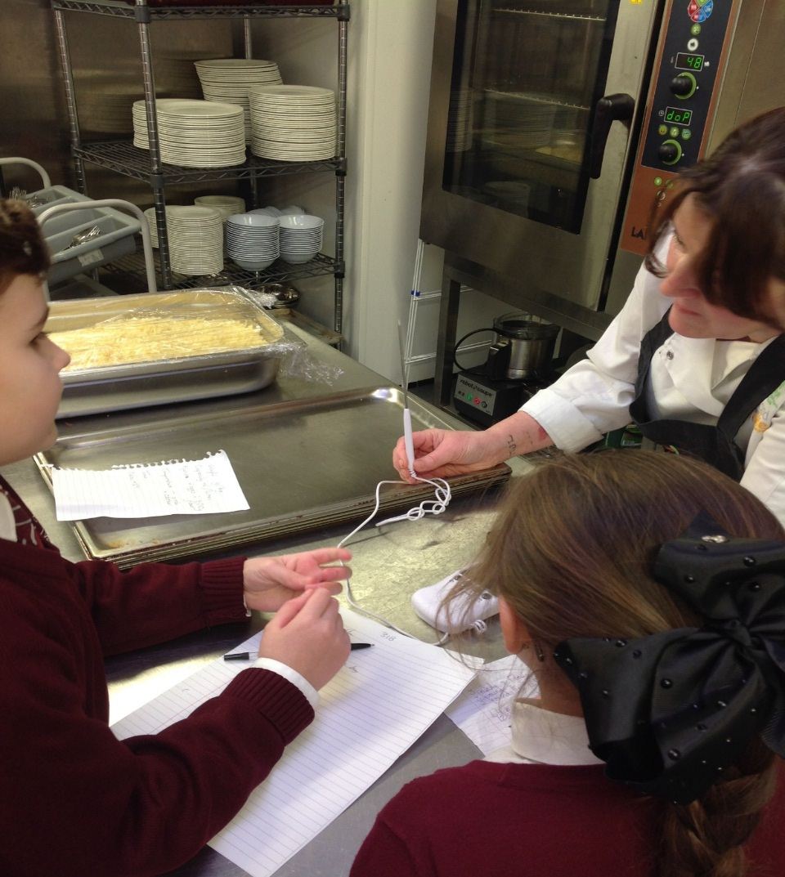
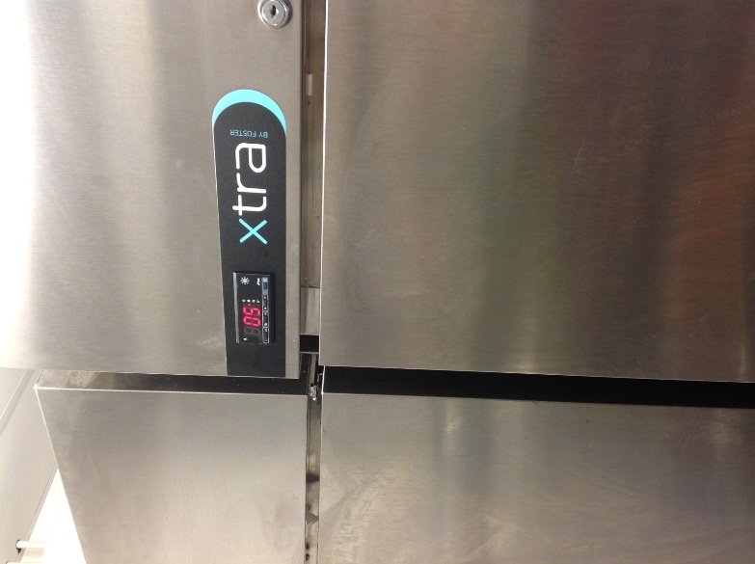
Temperature is vital to ensure food is safe to eat.
All cooked food has to be 75 ℃ or over before being served.

Slide 9
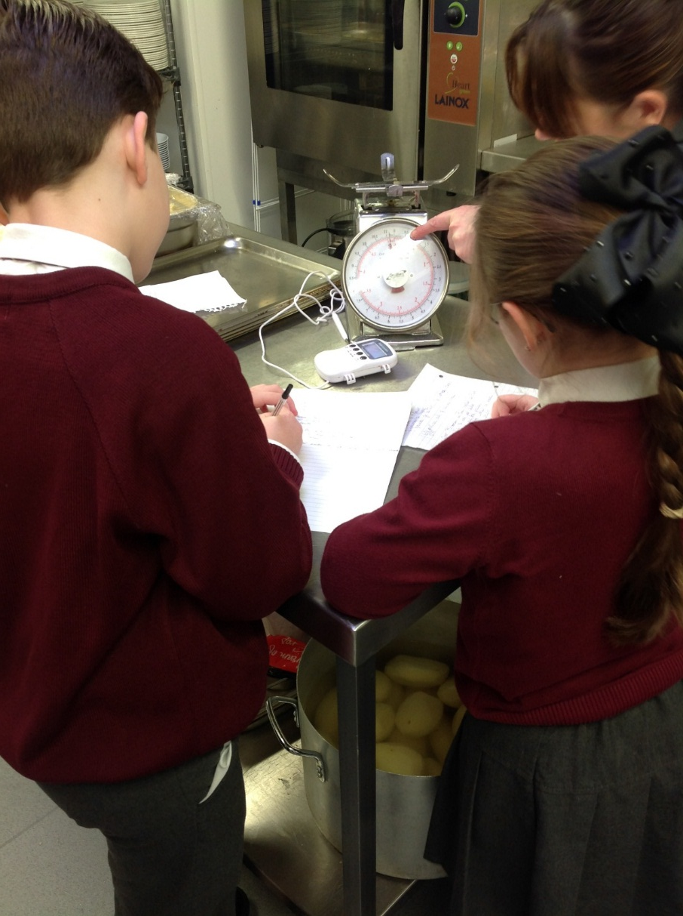
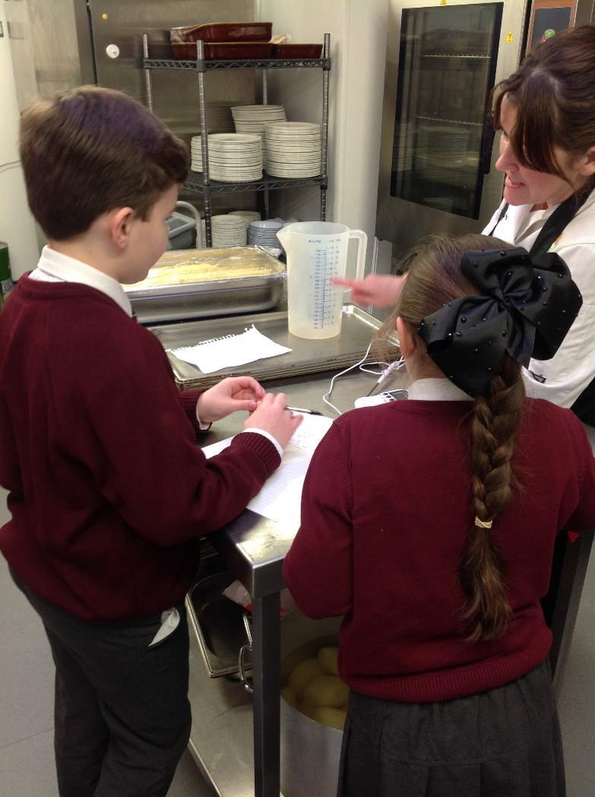
Weighing and measuring is important to ensure the correct amount of ingredients are used.
Did you know it takes 28 pints of water to make 120 portions of jelly?

Slide 10
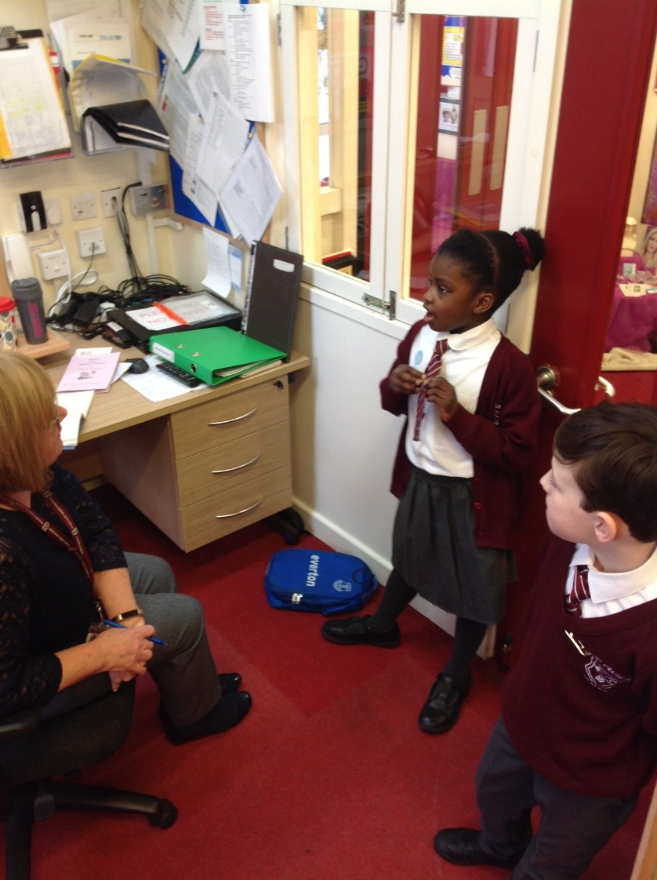
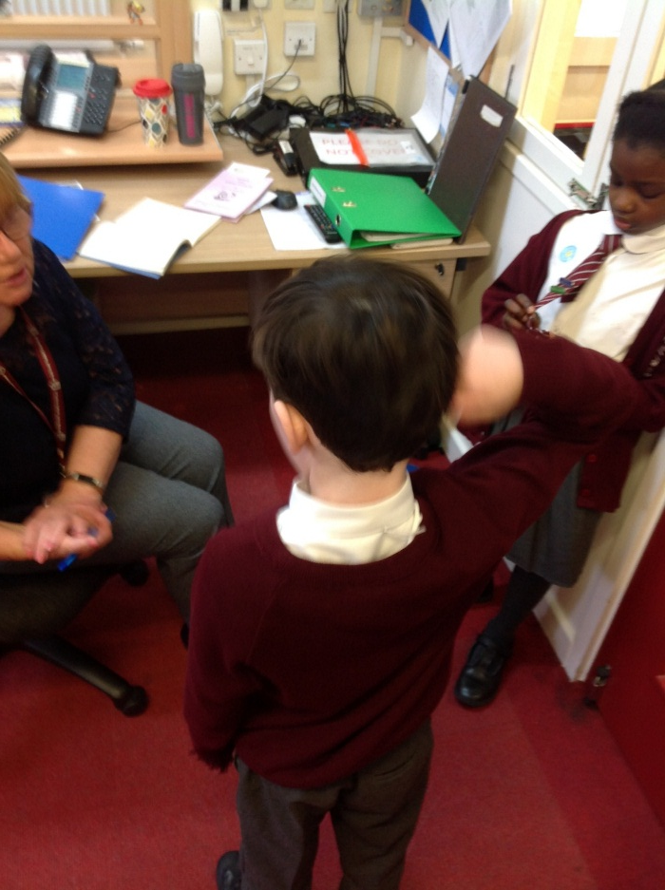
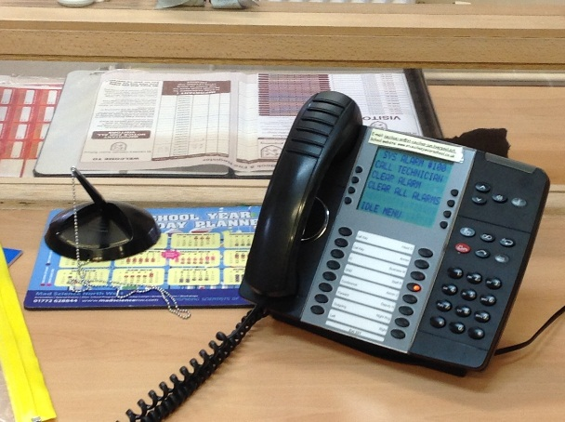
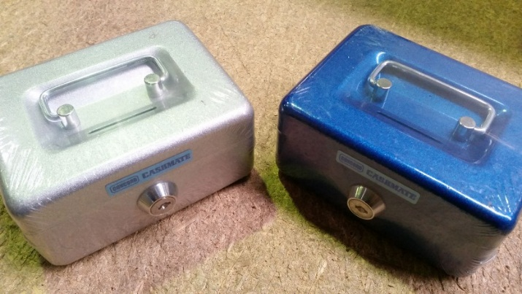
Mrs Donnelly uses maths everyday to keep track of budgeting, spending and saving.

Slide 11
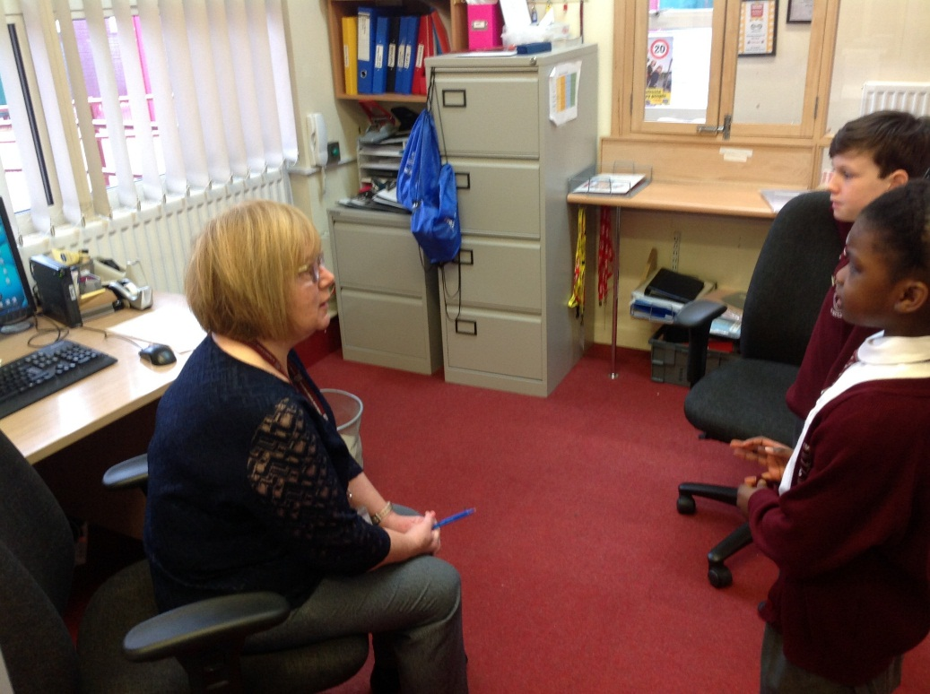
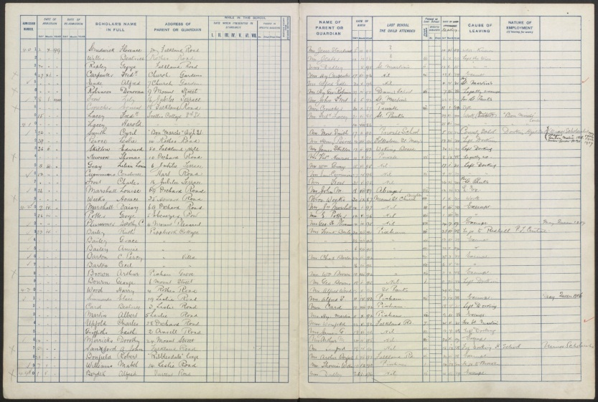
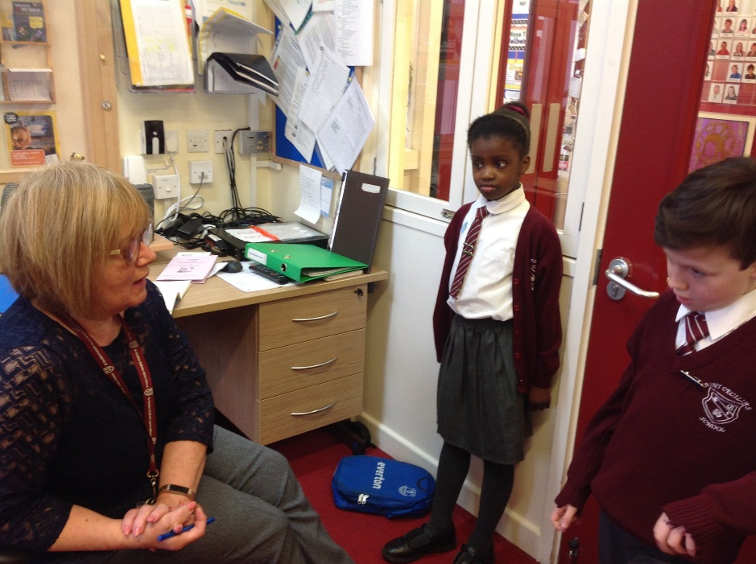
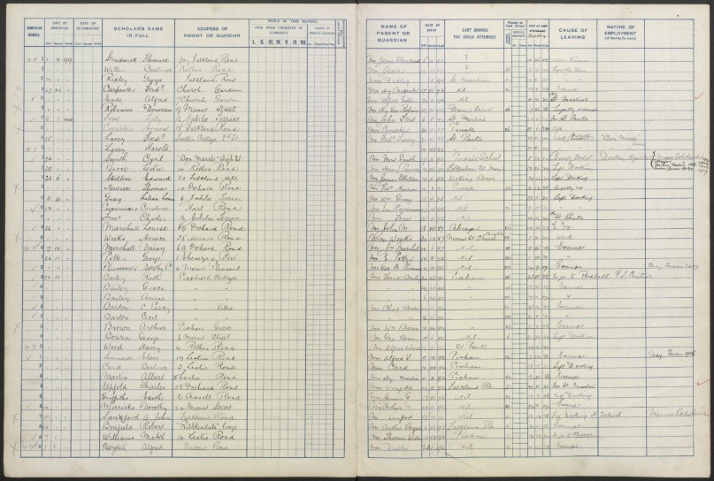
Maths is also used everyday to work out attendance and punctuality.

Slide 12
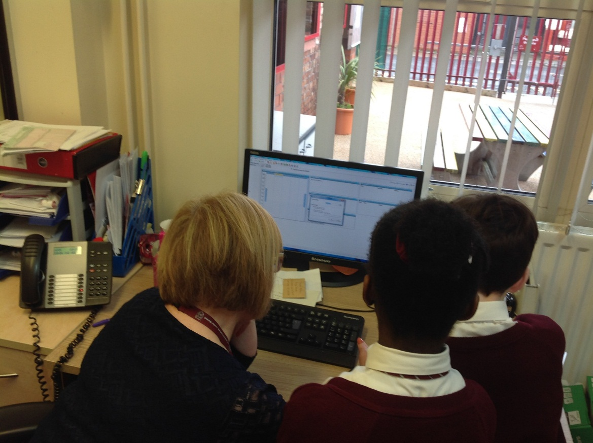
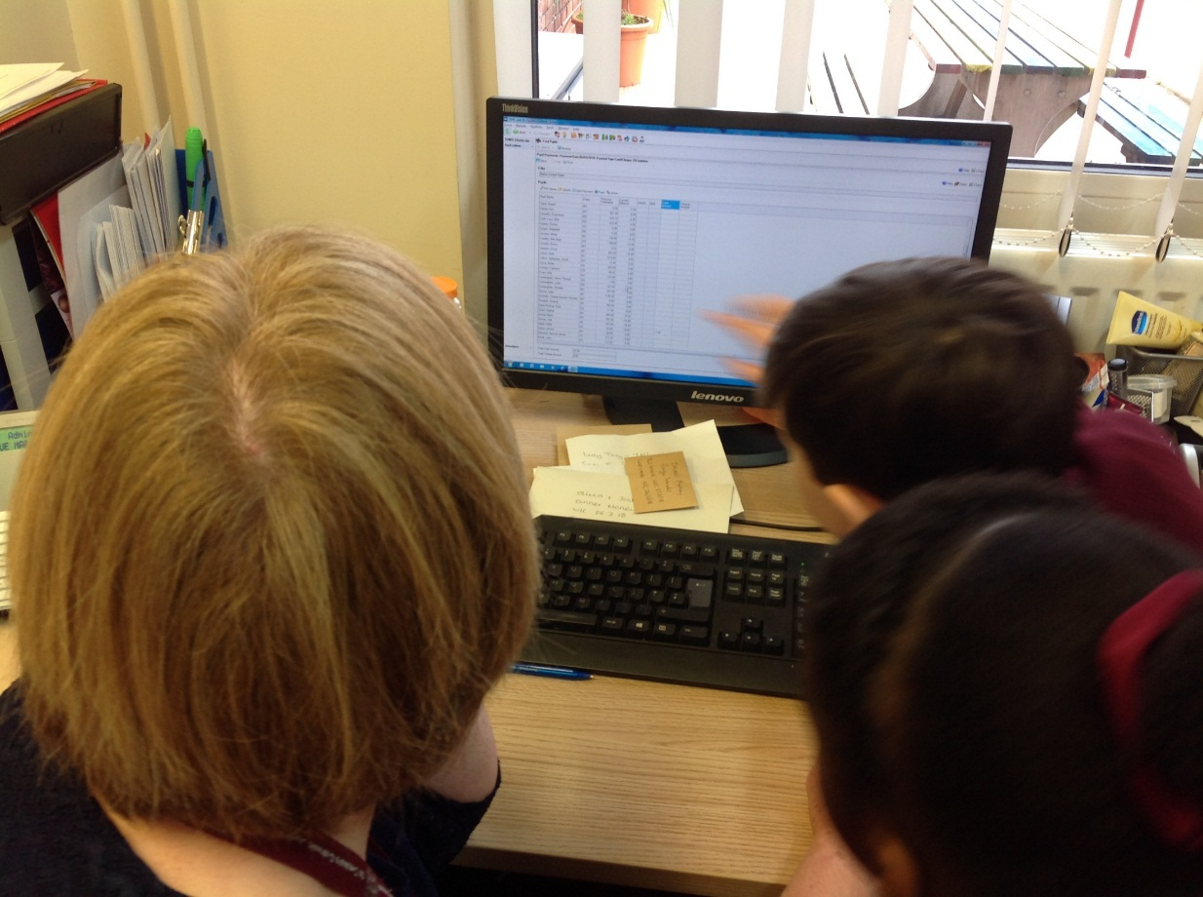
Mrs Donnelly showed us how the dinner money is recorded.
On that day 115 pupils were having hot dinners, that is half of the school!

Slide 13
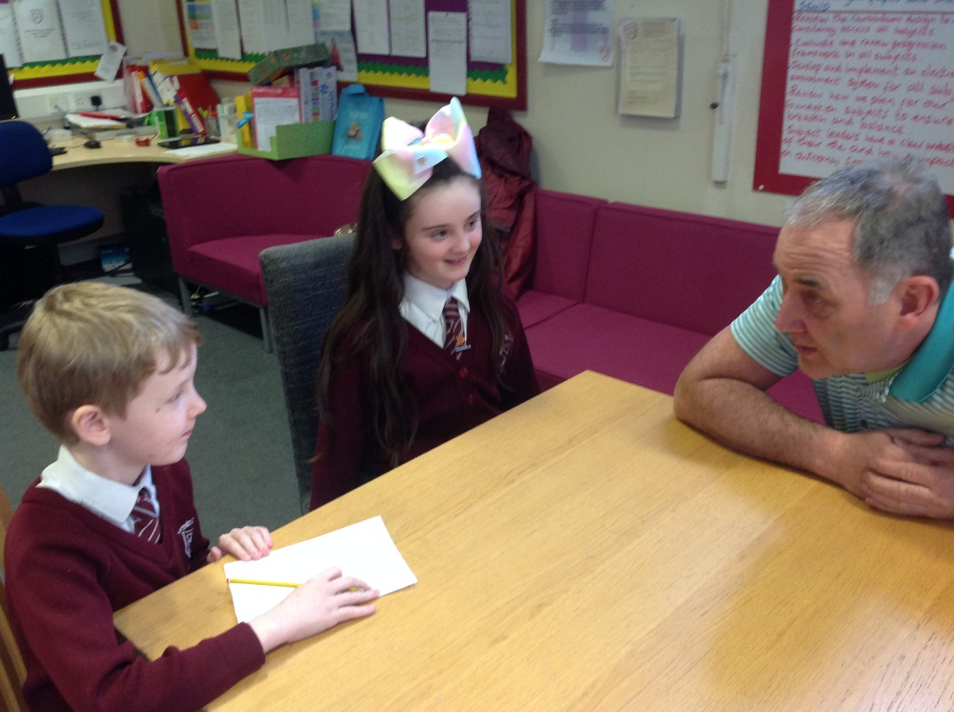
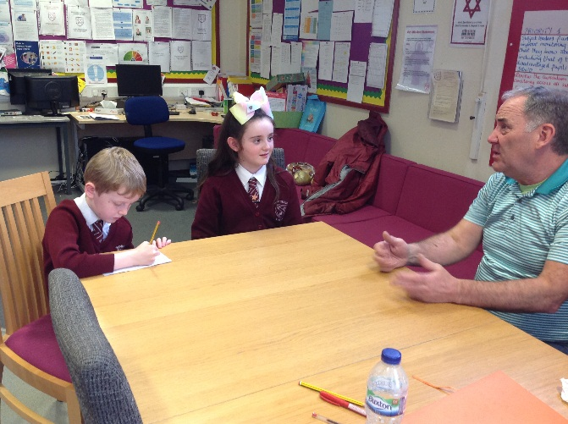
We interviewed Mr Goodall to see how he used maths everyday.
He uses maths to measure and fit the shutters to keep the school secure.

Slide 14
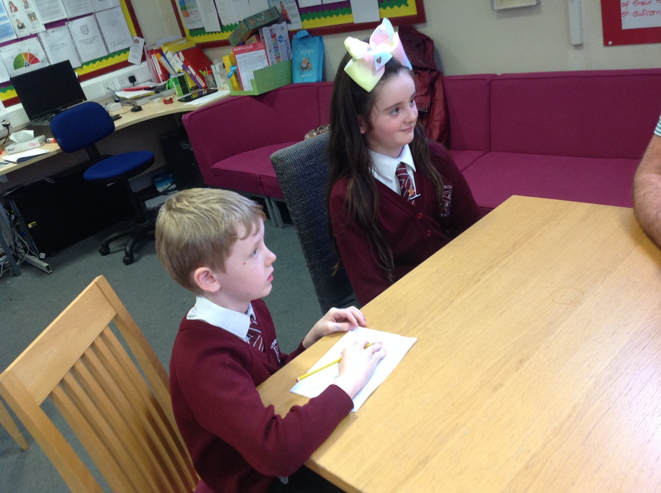
He explained how he uses maths to work out how much paint he needs to paint our classrooms.

Slide 15
So next time you say you don’t need maths remember, maths is important and we use it every day.

Slide 16
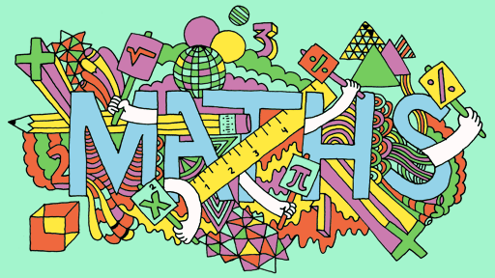
Thank you for listening.

