Slide 1
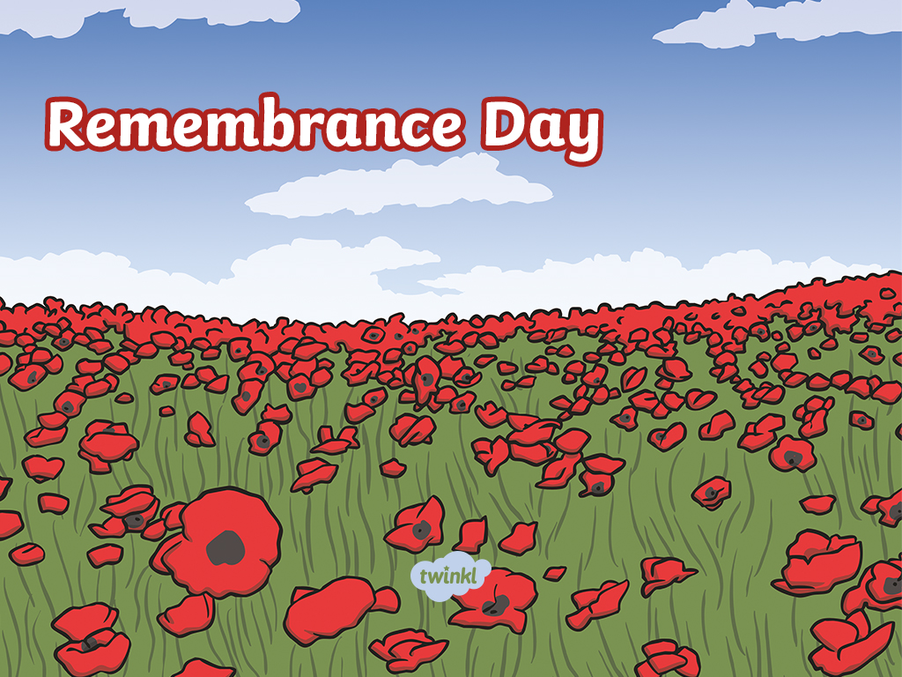
Prayers
Y5-2

Slide 2
On Monday the 11th day of the 11th month at 11:00am we remembered all of those soldiers who died as a result of war.
They gave their lives so that we may have our freedom.
Today we ask for God’s love to enfold the families of those who do the job of protecting us, past or present.

Slide 3
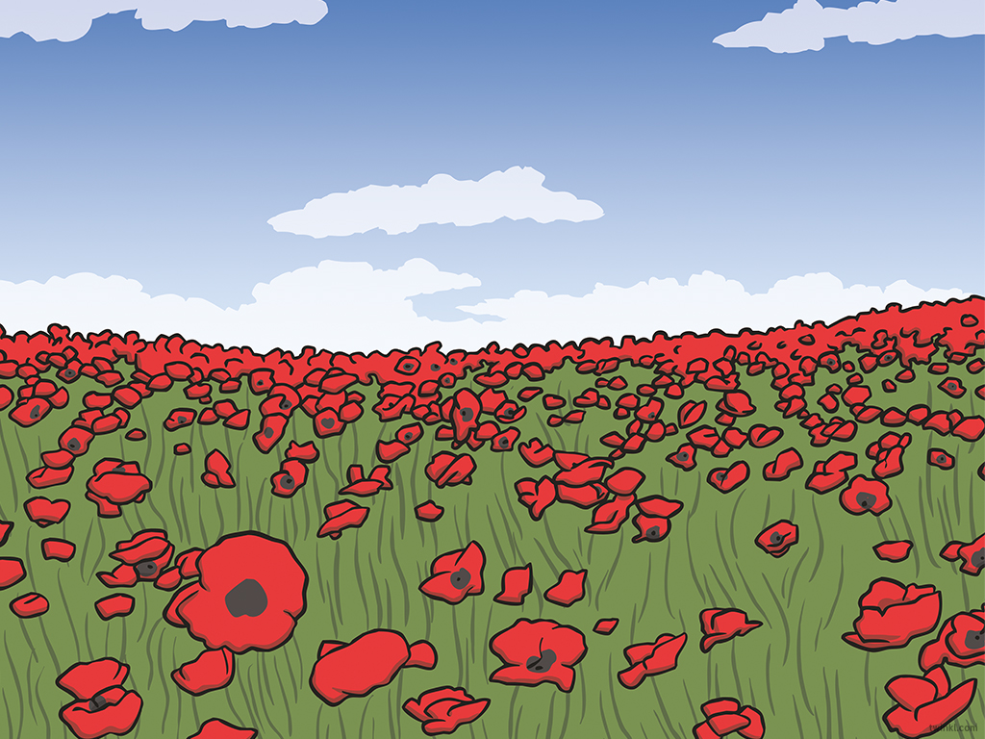
Dear Lord,
Please look after the many who have risked their lives for the future of British people and others around the world.
There are still soldiers who are keeping us safe in other countries right now.
Please help us to make peace with our enemies and let there be no more unwanted deaths.
Lord hear us
Lord graciously hear us

Slide 4
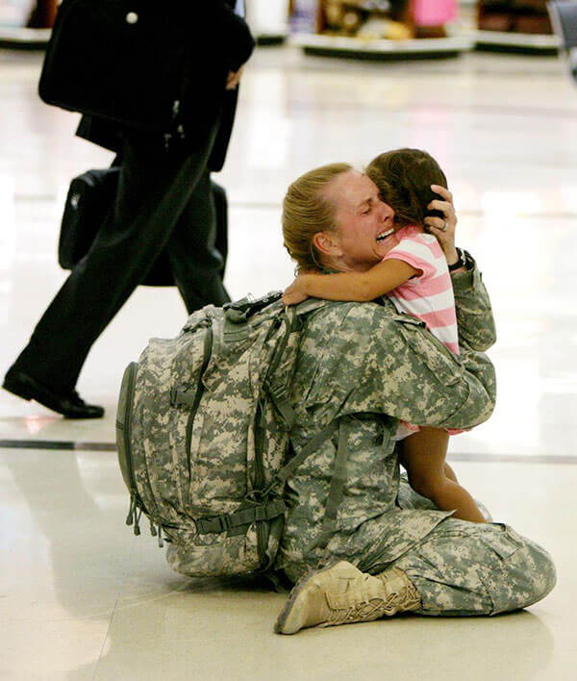
Dear Lord,
We pray for those soldiers who died during the war, trying to save our country.
We hope that any soldiers who take part in war, living or dead, can be reunited with their families.
Lord Hear Us
R: Lord graciously hear us

Slide 5
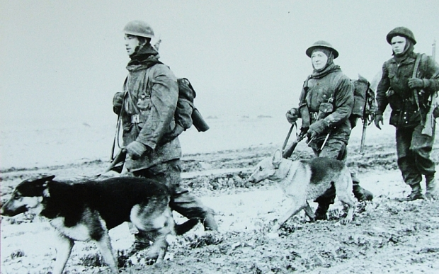
Dear Lord,
Please help the animals around the world some of whom have given their service and lives to us as they do their job.
Lord hear us
R. Lord graciously
hear us

Slide 6
Dear Lord,
We are sorry that we bring countries at war with each other and getting people killed for no necessary reason.
Help us to make good choices and find alternatives to war.
Lord here us
Lord graciously hear us

Slide 7
Dear God,
Please help and guide us to be kind and live in peace, the way you wanted us to.
Lord hear us
Lord graciously hear us

Slide 8
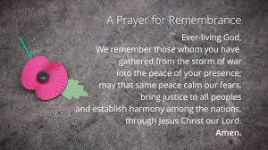
We pray together and say…

Slide 9


