Slide 1
As we gather…
Listen carefully to the music and try to empty your mind of all other thoughts from the day.
Take this opportunity, to listen to the sounds of nature and to be still…

Slide 2
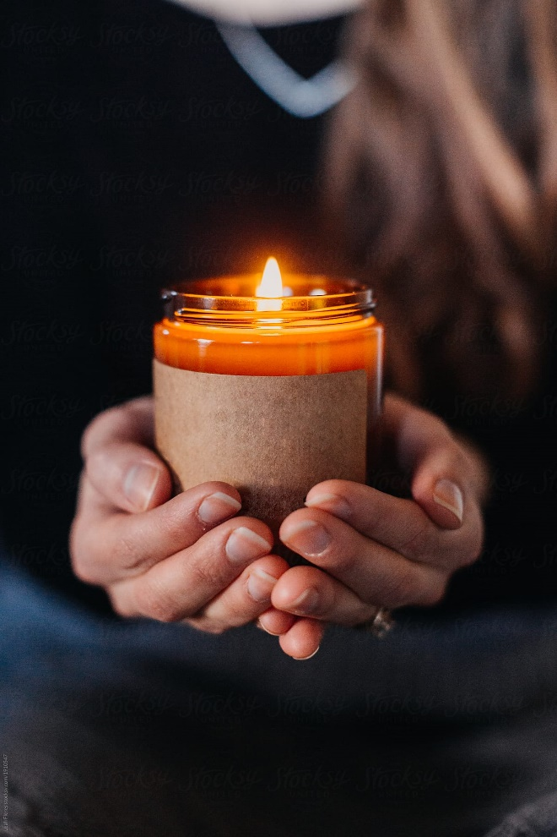
Know that God is with us.

Slide 3

We answered the call and chose to teach in a Catholic school.
The theme of our collective worship

Slide 4
May the God who dances in creation,
Who embraces us with human love,
Who shares our lives like thunder,
Bless us and drive us out with power
And energise us in our work.

Slide 5
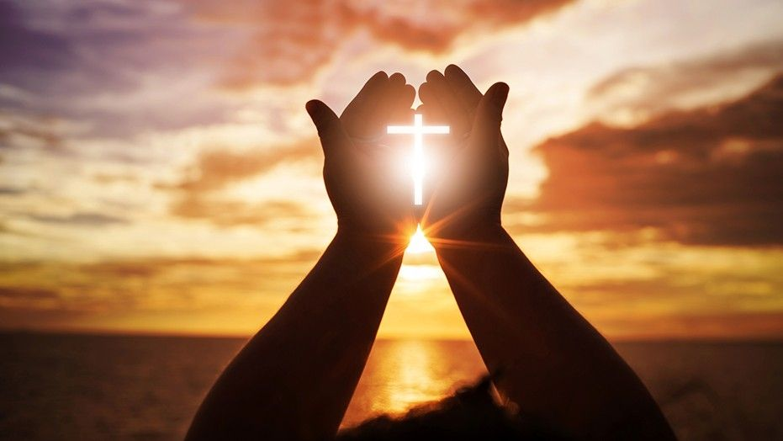
Be with us Lord as we pray…

Slide 6
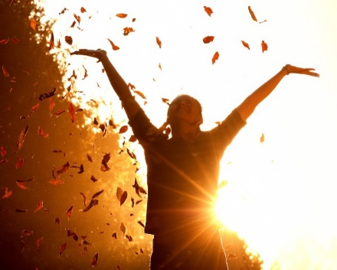
Listen to the Word…
A reading from one of St. Paul’s letters to the Philippians…

Slide 7
We respond in prayer…
Let us read and pray together.

Slide 8

A message to take forth…

Slide 9
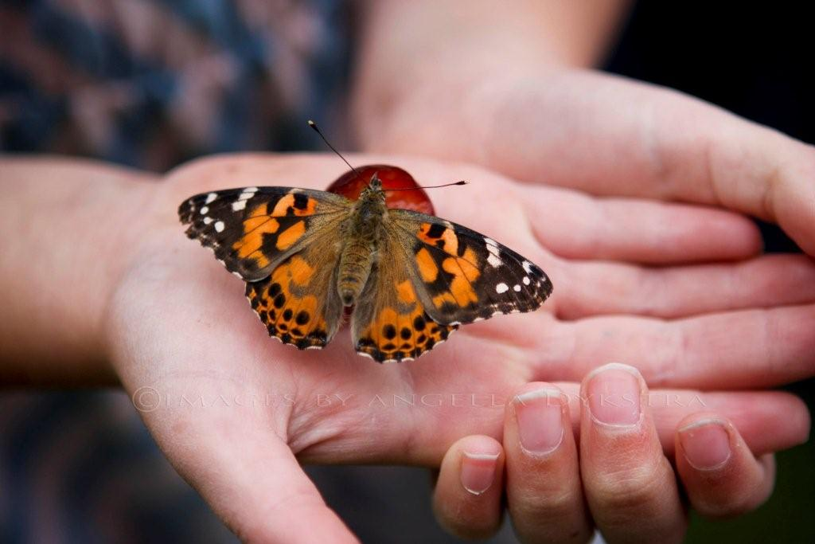
Butterflies

Slide 10
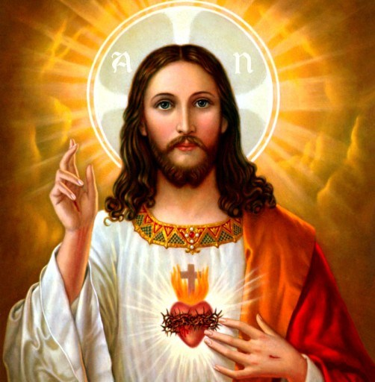
What would Jesus do?

