Slide 1
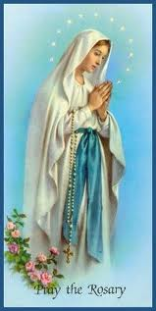
Our Lady of the Rosary

Slide 2
The 7th October, is the feast of Our Lady of the Rosary.

Slide 3
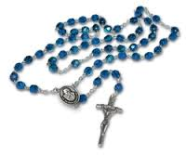
The Rosary is a special prayer said with rosary beads.
The word ‘rosary’ comes from Latin and means a garland of roses.
Roses are a symbol of Our Lady.

Slide 4
As we hold the rosary beads we say the ‘Hail Mary ‘ten times.
This is called a decade of the Rosary.

Slide 5
As we say the rosary we remember the events in the lives of Jesus, his mother Mary and his father , Joseph.

