Slide 1
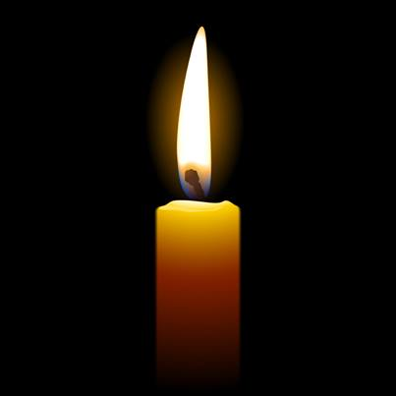
We gather…
As we gather, we light the candle to symbolise God being with us.
And we join our hands to let God know that we gather in prayer in his name.

Slide 2
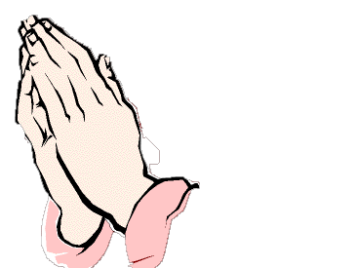
Sign of the cross..
This our school,
let peace dwell here,
Let the rooms be full of contentment.
Let love abide here;
love of one another; love of mankind, love of life itself
and love of God.
Let us remember that
As many hands build a house,
So many hearts build a school.

Slide 3
The theme of our collective worship is…

Slide 4

Is being a Catholic the only religion in the World?

Slide 5
We listen…

Slide 6

Islam
Islam

Slide 7

What is Islam?
Islam is the faith and way of life of over a billion people.
People who follow the faith of Islam are known as Muslims.

Slide 8

Where does Islam
originate from?
Islam originated in Saudi Arabia but
it is now a faith that is practiced world wide.
The highest density of Muslims are in Indonesia.

Slide 9
What does Islam mean?
The word Islam means ‘peace’.
The Islamic God is called ‘Allah’.

Slide 10
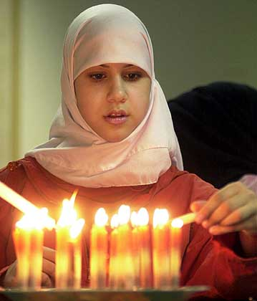
Islam is the religion of people called Muslims.
Muslims believe that someone is more important than themselves and they obey them. Muslims believe this person is God, whom they call Allah.
Muslims believe that there is one God and he is eternal.

Slide 11

What do we know about Allah?
Allah is the Arabic and Islamic name for One True God
Muslims believe that Allah created the universe out of nothing.
Allah has control over all events.
Muslims never try to draw Allah or identify him through images.

Slide 12
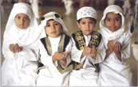
Muslims believe Prophets spread the word of Allah.
The last and most important prophet was a man called Muhammad.
This picture is of Muslim Children
Muslims believe that Muhammad received messages from Allah, given to him by an angel.

Slide 13
Who was Muhammad?
Muhammad was born in 570.
His father died around his birth and his mother died when he was 6 years old.
Muhammad was raised by his grandfather who was a tribal leader.

Slide 14
The Story of Muhammad
https://www.bbc.com/bitesize/clips/z9b9jxs

Slide 15
Muhammad’s life....
Muhammad married when he was 25 years old.
He was concerned that the people of Mecca were becoming more concerned with wealth than their religion.
Muhammad began to spend a lot of time alone in meditation praying for others.

Slide 16
What is the Qur’an?
The Qur’an is the holy book that Muslim’s use to guide them in their faith.
The Qur’an tells of Allah’s teachings. It is a very sacred book.

Slide 17
The Qur’an was written through Muhammad.
An Archangel called Gabriel appeared to Muhammad and informed him of Allah's teachings and wishes.
It took 22 years to complete the Qur’an.
How was the
Qur’an written?

Slide 18

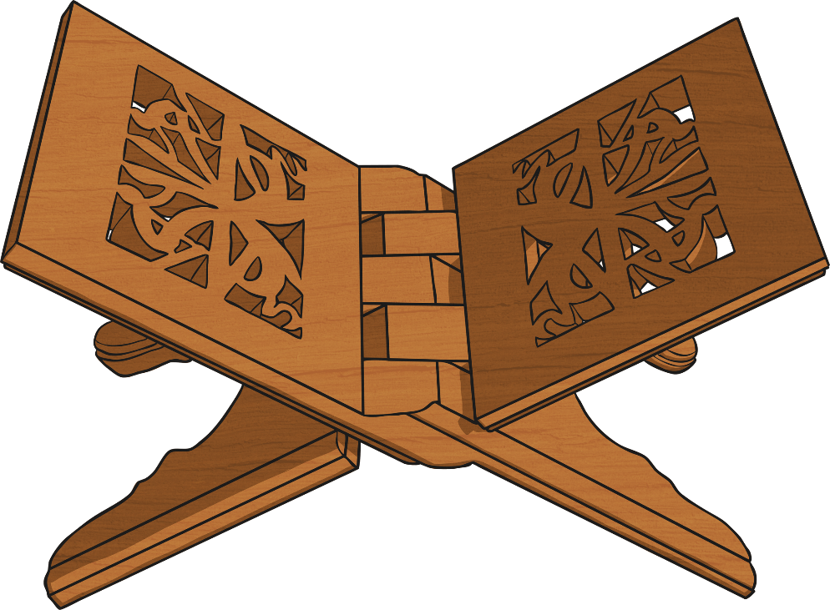
The Qur’an
Muslims treat the Qur’an with a huge amount of respect, as they believe it is literally from Allah and therefore every word is sacred.
The Qur’an is usually placed on a special wooden stand to be read.
Muslims believe that the Qur’an is the unaltered words of Allah.
How is the Qur’an similar to holy books in other religions?
Is it different in any way?

Slide 19

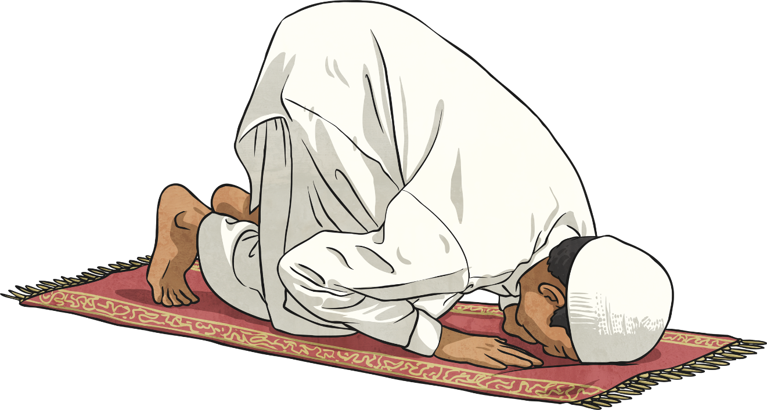
Muslim prayers
Think about how many times we say prayers during our school day. Then we pray before bed at night. Collective worship means praying together. Muslims do that too.

Slide 20
Take a look at the importance of Muslim prayer.
https://www.bbc.com/bitesize/clips/z9r87ty

Slide 21
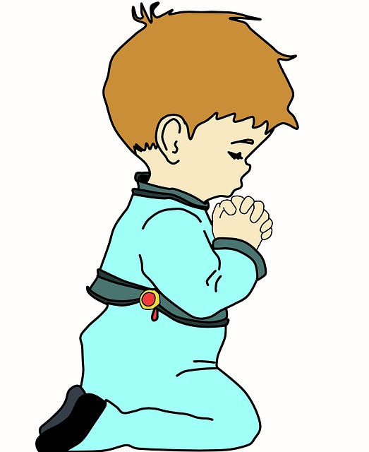
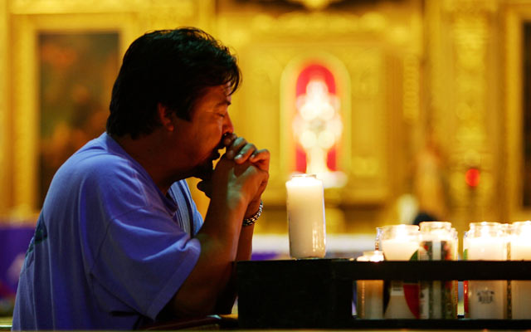
Can you think of any similarities between Christian prayer and Muslim prayer?

Slide 22
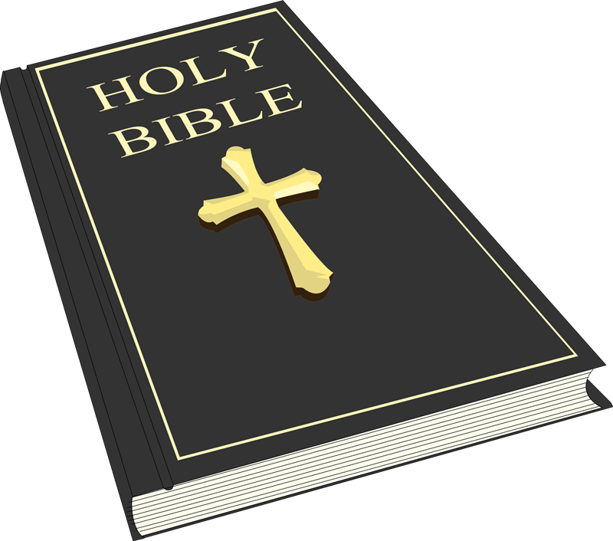
We Listen to the Word…

Slide 23
Colossians 3:13-23
Be tolerant with one another and forgive one another whenever any of you has a complaint against someone else. You must forgive one another just as the Lord has forgiven you. And to all these qualities add love, which binds all things together in perfect unity. The peace that Christ gives is to guide you in the decisions you make; for it is to this peace that God has called you together in the one body. And be thankful. Christ's message in all its richness must live in your hearts. Teach and instruct one another with all wisdom. Sing psalms, hymns, and sacred songs; sing to God with thanksgiving in your hearts.

Slide 24
Everything you do or say, then, should be done in the name of the Lord Jesus, as you give thanks through him to God the Father. Wives, submit yourselves to your husbands, for that is what you should do as Christians. Husbands, love your wives and do not be harsh with them. Children, it is your Christian duty to obey your parents always, for that is what pleases God. Parents, do not irritate your children, or they will become discouraged. Slaves, obey your human masters in all things, not only when they are watching you because you want to gain their approval; but do it with a sincere heart because of your reverence for the Lord. Whatever you do, work at it with all your heart, as though you were working for the Lord and not for people.

Slide 25
We respond…
Dear Lord,
help us to see the wonder in all different religions around the world.
Give us the ability to appreciate the similarities and differences of all cultures and religions and to show tolerance and Christianity whenever we listen to the views of those who don’t act as you would.
Lord in your mercy
Hear our prayer.

Slide 26
Go forth…
Today we will practise our faith by making prayer a very important part of our day too.
Spend time praying to God in thanks or for help, for yourself or for others who need your prayers.
Say prayers before bed and talk to God

